Slide 1
Google Colaboratory
Short Introduction

Slide 2
What is Google Colab?
It is a free cloud service that lets you run python code without setting up any environment or installing it in your local machine.
It is a jupyter notebook environment that requires no setup and completely runs in the cloud.
Every new notebook you create in Colab can be directly stored in your google drive.

Slide 3
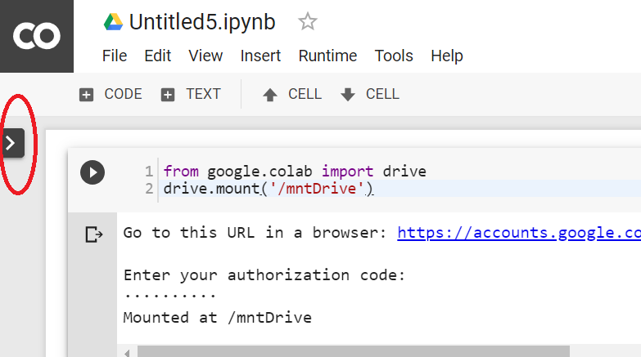
Colab Interface

Slide 4
Colab Features
A colab notebook consist of a list of cells and each cell can contain text, python code, images etc.
To execute a cell and see its output below the cell either click on the play button found in the top-left corner of the cell or press Ctrl+Enter.
It offers a free GPU and TPU service that can be used for tasks such as Machine learning, Deep Learning and Data Science.

Slide 5
Magic Commands
Magic commands is a set of system commands that provides a mini extensive command language.
It lets you render HTML, SVG and also run Linux commands in a colab cell.
For a complete list of magic commands: %lsmagic

Slide 6
Using Google Colab with GitHub
Google Colab is designed to integrate cleanly with GitHub, allowing both loading notebooks from github and saving notebooks to github.
Colab can load public github notebooks directly, with no required authorization step
Ex: https://colab.research.google.com/github/googlecolab/colabtools/blob/master/notebooks/colab-github-demo.ipynb.
http://colab.research.google.com/github will give you a general github browser, where you can search for any github organization or username.

